Slide 1
Chapter -2
Static and dynamic routing

Slide 2
Static Routing
Remote networks are added to the routing table either by configuring static routes or enabling a dynamic routing protocol.
A static route includes the network address and subnet mask of the remote network, along with the IP address of the next-hop router or exit interface.
Static routes should be used in the following cases:
  A network consists of only a few routers.
  A network is connected to the Internet only through a single ISP.
  A large network is configured in a hub-and-spoke topology.

Slide 3
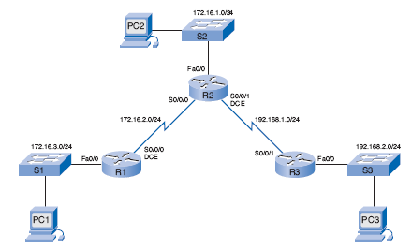
Introducing the Topology

Slide 4
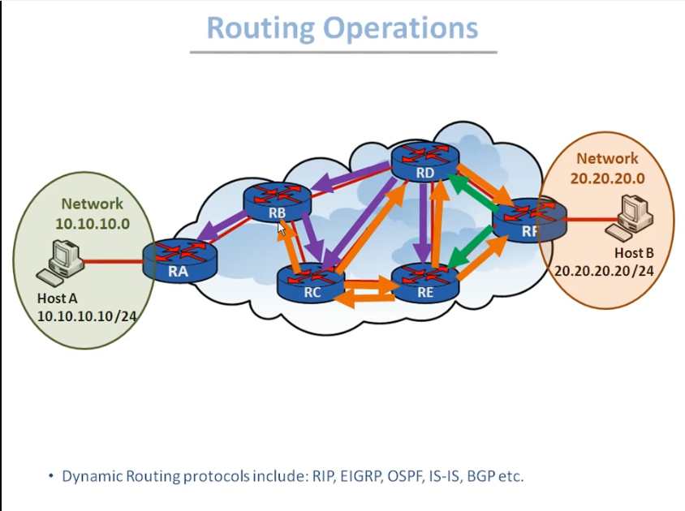
U

Slide 5
Routing algorithms
How does a router find a best path?
•Most solutions based on SPF (Shortest Path First) algorithms that are
well known in graph theory.
–Bellman-Ford
–Dijkstra
•Link-State protocols (OSPF, IS-IS) use Dijkstra
•Distance-Vector protocols (RIP, IGRP, BGP) use Bellman-Ford

Slide 6
Routing algorithms
Apart from that, there may also be other algorithms in
–Multicast routing
–Ad-hoc routing
–Sensor networks
–Delay-tolerant networks

Slide 7
Interfaces and their Statuses
R1# show interfaces
FastEthernet0/0 is administratively down, line protocol is down
Hardware is AmdFE, address is 000c.3010.9260 (bia 000c.3010.9260)
<output omitted>
Serial0/0/0 is administratively down, line protocol is down
<output omitted>
R1# show ip interface brief
Interface IP-Address OK? Method Status Protocol
FastEthernet0/0 unassigned YES manual administratively down down
Serial0/0 unassigned YES unset administratively down down
FastEthernet0/1 unassigned YES unset administratively down down
Serial0/1 unassigned YES unset administratively down down
R1#
Used to see a portion of the interface information in a condensed format

Slide 8
Configuring an Ethernet Interface
R1(config)# interface fastethernet 0/0
R1(config-if)# ip address 172.16.3.1 255.255.255.0
R1(config-if)# no shutdown
*Mar 1 01:16:08.212: %LINK-3-UPDOWN: Interface FastEthernet0/0, changed state to up
*Mar 1 01:16:09.214: %LINEPROTO-5-UPDOWN: Line protocol on Interface
FastEthernet0/0, changed state to up
changed state to up message indicates that, physically, the connection is good.
  If you do not get this first message, be sure that the interface is properly connected to a switch or a hub.
  An Ethernet interface will not be active, or up, unless it is receiving a carrier signal from another device (switch, hub, PC, or another router).
changed state to up message indicates that the data link layer is operational.
  On LAN interfaces, you do not normally change the data link layer parameters.
  However, WAN interfaces in a lab environment require clocking on one side of the link.

Slide 9
Commands to Verify Interface Configuration
R1# show interfaces fastethernet 0/0
FastEthernet0/0 is up, line protocol is up
Hardware is AmdFE, address is 000c.3010.9260 (bia 000c.3010.9260)
Internet address is 172.16.3.1/24
<output omitted>
R1# show ip interface brief
Interface IP-Address OK? Method Status Protocol
FastEthernet0/0 172.16.3.1 YES manual up up
Serial0/0/0 unassigned YES unset administratively down down
FastEthernet0/1 unassigned YES unset administratively down down
Serial0/0/1 unassigned YES unset administratively down down
R1# show running-config
<output omitted>
interface FastEthernet0/0
ip address 172.16.3.1 255.255.255.0
<output omitted>

Slide 10
Configuring a Serial Interface
R1(config)# interface serial 0/0/0
R1(config-if)# ip address 172.16.2.1 255.255.255.0
R1(config-if)# no shutdown
R1# show interfaces serial 0/0/0
Serial0/0/0 is down, line protocol is down
Hardware is PowerQUICC Serial
Internet address is 172.16.2.1/24
MTU 1500 bytes, BW 1544 Kbit, DLY 20000 usec,
<output omitted>
After entering these commands, the state of the serial interface might vary depending on the type of WAN connection.
The serial interface will be in the up state only after the other end of the serial link has also been properly configured.

Slide 11
Configuring a Serial Interface
R1(config)# interface serial 0/0/0
R1(config-if)# ip address 172.16.2.1 255.255.255.0
R1(config-if)# no shutdown
R2(config)# interface serial 0/0/0
R2(config-if)# ip address 172.16.2.2 255.255.255.0
R2(config-if)# no shutdown
There is no requirement that both ends of the serial link use the same interface, in this case, Serial 0/0/0.
However, because both interfaces are members of the same network, they both must have IP addresses that belong to the 172.16.2.0/24 network.

Slide 12
Configuring a Serial Interface
R2# show interfaces serial 0/0/0
Serial0/0/0 is up, line protocol is down
<output omitted>
Physical link between R1 and R2 is up because both ends of the serial link have been configured correctly with an IP address/mask and enabled with the no shutdown command.
However, the line protocol is still down.
This is because the interface is not receiving a clock signal.
There is still one more command that you need to enter, the clock rate command, on the router with the DCE cable.
The clock rate command will set the clock signal for the link.
Typically, the router is the DTE device and is connected to a CSU/DSU, which is the DCE device.
Serial interfaces require a clock signal to control the timing of the communications.
In most environments, the service provider (a DCE device such as a CSU/DSU) will provide the clock.
By default, routers are DTE devices.

Slide 13
Configuring Serial Links in a Lab Environment
In a lab environment, one side of a connection must be considered a DCE and provide a clocking signal.
Although serial interfaces are DTE devices by default, they can be configured as DCE devices.
R1(config)# interface serial 0/0/0
R1(config-if)# clock rate 64000
01:10:28: %LINEPROTO-5-UPDOWN: Line protocol on Interface Serial0/0/0, changed state to up
Available clock rates, in bits per second, are 1200, 2400, 9600, 19200, 38400, 56000, 64000, 72000, 125000, 148000, 500000, 800000, 1000000, 1300000, 2000000, and 4000000.
If a router’s interface with a DTE cable is configured with the clock rate command, the IOS will disregard the command and there will be no ill effects.

Slide 14
Verifying the Serial Interface Configuration
R1# show interfaces serial 0/0/0
Serial0/0/0 is up, line protocol is up
Hardware is PowerQUICC Serial
Internet address is 172.16.2.1/24
<output omitted>
R1# show ip interface brief
Interface IP-Address OK? Method Status Protocol
FastEthernet0/0 172.16.3.1 YES manual up up
Serial0/0/0 172.16.2.1 YES manual up up
<output omitted>
R1# show ip route
<output omitted>
Gateway of last resort is not set
172.16.0.0/24 is subnetted, 2 subnets
C 172.16.2.0 is directly connected, Serial0/0/0
C 172.16.3.0 is directly connected, FastEthernet0/0
172.16.2.0/24 serial network is now in the routing table for R1

Slide 15
Routing Table Concepts
The routing table consists of a list of “known” network addresses—that is, those addresses that are directly connected, configured statically, and learned dynamically.
R1 and R2 only have routes for directly connected networks.
R1# show ip route
<output omitted>
Gateway of last resort is not set
172.16.0.0/24 is subnetted, 2 subnets
C 172.16.2.0 is directly connected, Serial0/0/0
C 172.16.3.0 is directly connected, FastEthernet0/0
R2# show ip route
<output omitted>
Gateway of last resort is not set
172.16.0.0/24 is subnetted, 1 subnets
C 172.16.2.0 is directly connected, Serial0/0/0

Slide 16
The rest of the configurations for Routers R2 and R3.
R2(config)# interface serial 0/0/1
R2(config-if)# ip address 192.168.1.2 255.255.255.0
R2(config-if)# clock rate 64000
R2(config-if)# no shutdown
R2(config-if)# interface fastethernet 0/0
R2(config-if)# ip address 172.16.1.1 255.255.255.0
R2(config-if)# no shutdown
R3(config)# interface fastethernet 0/0
R3(config-if)# ip address 192.168.2.1 255.255.255.0
R3(config-if)# no shutdown
R3(config-if)# interface serial 0/0/1
R3(config-if)# ip address 192.168.1.1 255.255.255.0
R3(config-if)# no shutdown

Slide 18
Verifying Configurations
R1# show ip route
172.16.0.0/24 is subnetted, 2 subnets
C 172.16.2.0 is directly connected, Serial0/0/0
C 172.16.3.0 is directly connected, FastEthernet0/0
R2# show ip route
172.16.0.0/24 is subnetted, 2 subnets
C 172.16.1.0 is directly connected, FastEthernet0/0
C 172.16.2.0 is directly connected, Serial0/0/0
C 192.168.1.0/24 is directly connected, Serial0/0/1
R3# show ip route
C 192.168.1.0/24 is directly connected, Serial0/0/1
C 192.168.2.0/24 is directly connected, FastEthernet0/0

Slide 19
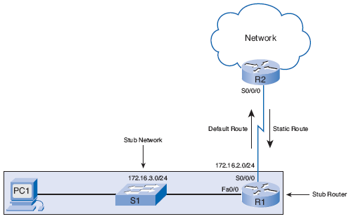
Static Routes with “Next-Hop” Addresses

Slide 20
Static routes
Static routes are commonly used when routing from a network to a stub network.
A stub network is a network accessed by a single route.
Here you see that any network attached to R1 would only have one way to reach other destinations, whether to networks attached to R2 or to destinations beyond R2.
Therefore, network 172.16.3.0 is a stub network and R1 is a stub router.
Running a routing protocol between R1 and R2 is a waste of resources because R1 has only one way out for sending nonlocal traffic.
Therefore, static routes are configured for connectivity to remote networks that are not directly connected to a router.

Slide 21
ip route Command
The command for configuring a static route is ip route.
Simpler version of the syntax:
Router(config)# ip route network-address subnet-mask {ip-address | exit-interface}
The following parameters are used:
  network-address: Destination network address of the remote network to be added to the routing table.
  subnet-mask: Subnet mask of the remote network to be added to the routing table. The subnet mask can be modified to summarize a group of networks.
One or both of the following parameters must also be used:
  ip-address: Commonly referred to as the next-hop router’s IP address.
  exit-interface: Outgoing interface that would be used in forwarding packets to the destination network.

Slide 22
Introducing the Topology

Slide 23
Configuring Static Routes
R1 in our topology knows about its directly connected networks.
The remote networks that R1 does not know about are as follows:
  172.16.1.0/24: The LAN on R2
  192.168.1.0/24: The serial network between R2 and R3
  192.168.2.0/24: The LAN on R3
R1(config)# ip route 172.16.1.0 255.255.255.0 172.16.2.2
Examining each element in this output reveals the following:
  ip route: Static route command
  172.16.1.0: Network address of remote network
  255.255.255.0: Subnet mask of remote network
  172.16.2.2: Serial 0/0/0 interface IP address on R2, which is the next hop to this network.
When the IP address is the actual next-hop router’s IP address, this IP address is reachable from one of this router’s directly connected networks.
In other words, the next-hop IP address 172.16.2.2 belongs to Router R1’s directly connected Serial 0/0/0 network 172.16.2.0/24..

Slide 24
Configuring Routes to Two or More Remote Networks
R1(config)# ip route 192.168.1.0 255.255.255.0 172.16.2.2
R1(config)# ip route 192.168.2.0 255.255.255.0 172.16.2.2
R1(config)# end
R1# show ip route
172.16.0.0/24 is subnetted, 3 subnets
S 172.16.1.0 [1/0] via 172.16.2.2
C 172.16.2.0 is directly connected, Serial0/0/0
C 172.16.3.0 is directly connected, FastEthernet0/0
S 192.168.1.0/24 [1/0] via 172.16.2.2
S 192.168.2.0/24 [1/0] via 172.16.2.2
Notice that all three static routes configured on R1 have the same next-hop IP address: 172.16.2.2, because packets for all the remote networks must be forwarded to Router R2, the next hop router.

Slide 25
Configure R2 and R3 Static Routes
R2(config)# ip route 172.16.3.0 255.255.255.0 172.16.2.1
R2(config)# ip route 192.168.2.0 255.255.255.0 192.168.1.1
R3(config)# ip route 172.16.1.0 255.255.255.0 192.168.1.2
R3(config)# ip route 172.16.2.0 255.255.255.0 192.168.1.2
R3(config)# ip route 172.16.3.0 255.255.255.0 192.168.1.2

Slide 26
R1# show ip route
<output omitted>
172.16.0.0/24 is subnetted, 3 subnets
S 172.16.1.0 [1/0] via 172.16.2.2
C 172.16.2.0 is directly connected, Serial0/0/0
C 172.16.3.0 is directly connected, FastEthernet0/0
S 192.168.1.0/24 [1/0] via 172.16.2.2
S 192.168.2.0/24 [1/0] via 172.16.2.2
R2# show ip route
<output omitted>
172.16.0.0/24 is subnetted, 3 subnets
C 172.16.1.0 is directly connected, FastEthernet0/0
C 172.16.2.0 is directly connected, Serial0/0/0
S 172.16.3.0 [1/0] via 172.16.2.1
C 192.168.1.0/24 is directly connected, Serial0/0/1
S 192.168.2.0/24 [1/0] via 192.168.1.1
R3# show ip route
<output omitted>
172.16.0.0/24 is subnetted, 3 subnets
S 172.16.1.0 [1/0] via 192.168.1.2
S 172.16.2.0 [1/0] via 192.168.1.2
S 172.16.3.0 [1/0] via 192.168.1.2
C 192.168.1.0/24 is directly connected, Serial0/0/1
C 192.168.2.0/24 is directly connected, FastEthernet0/0

Slide 27
Static Routes with Exit Interfaces
Router(config)# ip route network-address subnet-mask {ip-address | exit-interface}
R1(config)# no ip route 192.168.2.0 255.255.255.0 172.16.2.2
R1(config)# ip route 192.168.2.0 255.255.255.0 serial 0/0/0
R1(config)# end
R1# show ip route
<output omitted>
172.16.0.0/24 is subnetted, 3 subnets
S 172.16.1.0 [1/0] via 172.16.2.2
C 172.16.2.0 is directly connected, Serial0/0/0
C 172.16.3.0 is directly connected, FastEthernet0/0
S 192.168.1.0/24 [1/0] via 172.16.2.2
S 192.168.2.0/24 is directly connected, Serial0/0/0
Notice that the entry in the routing table no longer refers to the next-hop IP address but refers directly to the exit interface.
This exit interface is the same one that the static route was resolved to when it used the next-hop IP address.
Resolve the route to an exit interface in a single lookup, the same Serial 0/0/0 interface.

Slide 28
Modifying Static Routes
There is no way to modify an existing static route.
The static route must be deleted and a new one configured.
R1(config)# no ip route 172.16.1.0 255.255.255.0 172.16.2.2
R1(config)# ip route 172.16.1.0 255.255.255.0 serial 0/0/0
R1(config)# no ip route 192.168.1.0 255.255.255.0 172.16.2.2
R1(config)# ip route 192.168.1.0 255.255.255.0 serial 0/0/0
R2(config)# no ip route 172.16.3.0 255.255.255.0 172.16.2.1
R2(config)# ip route 172.16.3.0 255.255.255.0 serial 0/0/0
R2(config)# no ip route 192.168.2.0 255.255.255.0 192.168.1.1
R2(config)# ip route 192.168.2.0 255.255.255.0 serial 0/0/1
R3(config)# no ip route 172.16.1.0 255.255.255.0 192.168.1.2
R3(config)# ip route 172.16.1.0 255.255.255.0 serial 0/0/1
R3(config)# no ip route 172.16.2.0 255.255.255.0 192.168.1.2
R3(config)# ip route 172.16.2.0 255.255.255.0 serial 0/0/1
R3(config)# no ip route 172.16.3.0 255.255.255.0 192.168.1.2
R3(config)# ip route 172.16.3.0 255.255.255.0 serial 0/0/1

Slide 29
Summary and Default Static Routes
Summarizing Routes to Reduce the Size of the Routing Table
Summary route is a single route that can be used to represent multiple routes.
Summary routes are generally a set of contiguous networks (but do not have to be) that have the same exit interface or next hop IP address.
Example:
  10.0.0.0/16, 10.1.0.0/16, 10.2.0.0/16, 10.3.0.0/16, 10.4.0.0/16, 10.5.0.0/16, all the way through 10.255.0.0/16
Can be represented by a single network address: 10.0.0.0/8.
Creating smaller routing tables makes the routing table lookup process more efficient, because there are fewer routes to search.
If one static route can be used instead of multiple static routes, the size of the routing table will be reduced.
In many cases, a single static route can be used to represent dozens, hundreds, or even thousands of routes.

Slide 30
Summarizing Routes to Reduce the Size of the Routing Table
R3:
ip route 172.16.1.0 255.255.255.0 Serial0/0/1
ip route 172.16.2.0 255.255.255.0 Serial0/0/1
ip route 172.16.3.0 255.255.255.0 Serial0/0/1
All three routes are forwarding traffic out the same Serial 0/0/1 interface can be summarized to the single 172.16.0.0 255.255.252.0
R3(config)# no ip route 172.16.1.0 255.255.255.0 serial0/0/1
R3(config)# no ip route 172.16.2.0 255.255.255.0 serial0/0/1
R3(config)# no ip route 172.16.3.0 255.255.255.0 serial0/0/1
R3(config)# ip route 172.16.0.0 255.255.252.0 serial0/0/1
Delete individual static routes.
Configure single summary route.

Slide 31
Default Static Route
A default route is used to represent all routes with zero or no bits matching.
In other words, when there are no routes that have a more specific match, the default route will be a match.
A default static route is a route that will match all packets.
Default static routes are used:
  To represent destination networks outside the router’s own routing domain.
    A common use is when connecting a company’s edge router to the ISP network.
  When no other routes in the routing table match the packet’s destination IP address—in other words, when a more specific match does not exist.
  When a router has only one other router to which it is connected.
  This condition is known as a stub router.

Slide 32
Configuring a Default Static Route
Router(config)# ip route 0.0.0.0 0.0.0.0 [exit-interface | ip-address ]
0.0.0.0 0.0.0.0 network address and mask is called a quad-zero route.
R1(config)# no ip route 172.16.1.0 255.255.255.0 serial 0/0/0
R1(config)# no ip route 192.168.1.0 255.255.255.0 serial 0/0/0
R1(config)# no ip route 192.168.2.0 255.255.255.0 serial 0/0/0
R1(config)# ip route 0.0.0.0 0.0.0.0 serial 0/0/0
Delete individual static routes.
Configure single default static route.

Slide 33
Verifying a Default Static Route
R1# show ip route
<some codes omitted>
* - candidate default, U - per-user static route, o - ODR
Gateway of last resort is 0.0.0.0 to network 0.0.0.0
172.16.0.0/24 is subnetted, 2 subnets
C 172.16.2.0 is directly connected, Serial0/0/0
C 172.16.3.0 is directly connected, FastEthernet0/0
S* 0.0.0.0/0 is directly connected, Serial0/0/0
A /0 mask indicates that zero or no bits are needed to match.
As long as a more specific match doesn’t exist, the default static route will match all packets.
Default routes are very common on routers.
Instead of routers having to store routes for all the networks in the Internet, they can store a single default route to represent any network that is not in the routing table.

Slide 34
Dynamic Routing
Dynamic routing protocols are used by routers to share information about the reachability and status of remote networks.
Dynamic routing protocols perform several activities, including:
  Network discovery
  Updating and maintaining routing tables.
IP Routing Protocols - Some of the more common dynamic routing protocols for routing IP packets:
  RIP (Routing Information Protocol)
  IGRP (Interior Gateway Routing Protocol)
  EIGRP (Enhanced Interior Gateway Routing Protocol)
  OSPF (Open Shortest Path First)
  IS-IS (Intermediate System-to-Intermediate System)
  BGP (Border Gateway Protocol)
routers contain a combination of static routes and dynamic routes in the routing tables.

Slide 35
The Purpose of Dynamic Routing Protocols
A routing protocol is a set of processes, algorithms, and messages that are used to exchange routing information and populate the routing table with the routing protocol's choice of best paths.
The purpose of a dynamic routing protocol includes:
  Discovery of remote networks
  Maintaining up-to-date routing information
  Choosing the best path to destination networks
  Ability to find a new best path if the current path is no longer available.

Slide 36
The Purpose of Dynamic Routing Protocols
Dynamic Routing Protocol Operation
All routing protocols have the same purpose - to learn about remote networks and to quickly adapt whenever there is a change in the topology.
The operations of a dynamic routing protocol vary depending upon the type of routing protocol and the routing protocol itself.
In general, the operations of a dynamic routing protocol can be described as follows:
  The router sends and receives routing messages on its interfaces.
  The router shares routing messages and routing information with other routers that are using the same routing protocol.
  Routers exchange routing information to learn about remote networks.
  When a router detects a topology change the routing protocol can advertise this change to other routers.

Slide 37
Static and dynamic routing advantages and disadvantages
Static routing advantages:
  Minimal CPU processing.
  Easier for administrator to understand.
  Easy to configure.
Static routing disadvantages:
  Configuration and maintenance is time-consuming.
  Configuration is error-prone, especially in large networks.
  Administrator intervention is required to maintain changing route information.
  Does not scale well with growing networks; maintenance becomes cumbersome.
  Requires complete knowledge of the whole network for proper implementation.

Slide 38
Dynamic routing advantages and disadvantages
Dynamic routing advantages:
  Administrator has less work maintaining the configuration when adding or deleting networks.
  Protocols automatically react to the topology changes.
  Configuration is less error-prone.
  More scalable, growing the network usually does not present a problem.
Dynamic routing disadvantages:
  Router resources are used (CPU cycles, memory and link bandwidth).
  More administrator knowledge is required for configuration, verification, and troubleshooting.

Slide 39
Dynamic Routing Protocols Classification
Routing protocols can be classified into different groups according to their characteristics.
The most commonly used routing protocols are:
  RIP - A distance vector interior routing protocol
  IGRP - The distance vector interior routing protocol
  OSPF - A link-state interior routing protocol
  IS-IS - A link-state interior routing protocol
  EIGRP - The advanced distance vector interior routing protocol
  BGP - A path vector exterior routing protocol

Slide 40
IGP and EGP
An autonomous system (AS) - otherwise known as a routing domain - is a collection of routers under a common administration.
Typical examples are a company's internal network and an Internet service provider's network.
Because the Internet is based on the autonomous system concept, two types of routing protocols are required: interior and exterior routing protocols.
These protocols are:
  Interior Gateway Protocols (IGP) are used for intra-autonomous system routing - routing inside an autonomous system.
  Exterior Gateway Protocols (EGP) are used for inter-autonomous system routing – routing between autonomous systems.

Slide 41
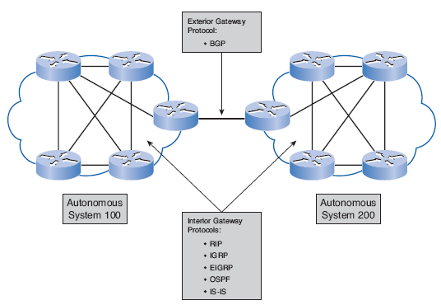

Slide 42
Distance Vector Routing Protocol Operation
Distance vector means that routes are advertised as vectors of distance and direction.
Distance is defined in terms of a metric such as hop count and direction is simply the next-hop router or exit interface.
Distance vector protocols typically use the Bellman-Ford algorithm for the best path route determination.
Some distance vector protocols periodically send complete routing tables to all connected neighbors.
In large networks, these routing updates can become enormous, causing significant traffic on the links.
Although the Bellman-Ford algorithm eventually accumulates enough knowledge to maintain a database of reachable networks, the algorithm does not allow a router to know the exact topology of an internetwork.

Slide 43
Distance Vector Routing Protocol Operation
The router only knows the routing information received from its neighbors.
The only information a router knows about a remote network is the distance or metric to reach that network and which path or interface to use to get there.
These protocols do not have an actual map of the network topology.
Distance vector protocols work best in situations where:
  The network is simple and flat, and does not require a special hierarchical design.
  The administrators do not have enough knowledge to configure and troubleshoot link-state protocols.
  Specific types of networks, such as hub-and-spoke networks, are being implemented.
  Worst-case convergence times in a network are not a concern.

Slide 44
Link-state Protocol Operation
In contrast to distance vector routing protocol operation, a router configured with a link-state routing protocol can create a "complete view" or topology of the network by gathering information from all of the other routers.
A link-state router uses the link-state information to create a topology map and to select the best path to all destination networks in the topology.
With some distance vector routing protocols, routers send periodic updates of their routing information to their neighbors.
Link-state routing protocols do not use periodic updates.
After the network has converged, a link-state update only sent when there is a change in the topology.
Link-state protocols work best in situations where:
  The network design is hierarchical, usually occurring in large networks.
  The administrators have a good knowledge of the implemented link-state routing protocol.
  Fast convergence of the network is crucial.

Slide 45
Classful and Classless routing protocols
Classful Routing Protocols
Classful routing protocols do not send subnet mask information in routing updates.
The first routing protocols such as RIP, were classful.
This was at a time when network addresses were allocated based on classes, class A, B, or C.
A routing protocol did not need to include the subnet mask in the routing update because the network mask could be determined based on the first octet of the network address.
Classful routing protocols can still be used in some of today's networks, but because they do not include the subnet mask they cannot be used in all situations.
Classful routing protocols cannot be used when a network is subnetted using more than one subnet mask, in other words classful routing protocols do not support variable length subnet masks (VLSM).
Classful routing protocols include RIPv1 and IGRP.

Slide 46
Classless Routing Protocols
Classless routing protocols include the subnet mask with the network address in routing updates.
Today's networks are no longer allocated based on classes and the subnet mask cannot be determined by the value of the first octet.
Classless routing protocols are required in most networks today because of their support for VLSM, and CIDR.
Classless routing protocols are:
  RIPv2,
  EIGRP,
  OSPF,
  IS-IS,
  BGP.

Slide 47
Convergence
Convergence is when all routers' routing tables are at a state of consistency.
The network has converged when all routers have complete and accurate information about the network.
Convergence time is the time it takes routers to share information, calculate best paths, and update their routing tables.
A network is not completely operable until the network has converged; therefore, most networks require short convergence times.
Convergence properties include the speed of propagation of routing information and the calculation of optimal paths.
Routing protocols can be rated based on the speed to convergence; the faster the convergence, the better the routing protocol.
Generally, RIP and IGRP are slow to converge, whereas EIGRP and OSPF are faster to converge.

Slide 48
Purpose of a Metric
There are cases when a routing protocol learns of more than one route to the same destination.
To select the best path, the routing protocol must be able to evaluate and differentiate between the available paths.
For this purpose a metric is used.
A metric is a value used by routing protocols to assign costs to reach remote networks.
The metric is used to determine which path is most preferable when there are multiple paths to the same remote network.
Each routing protocol uses its own metric.
For example, RIP uses hop count, EIGRP uses a combination of bandwidth and delay, and OSPF uses bandwidth.
Hop count is the easiest metric to envision.
The hop count refers to the number of routers a packet must cross to reach the destination network.

Slide 49
Metrics and Routing Protocols
Different routing protocols use different metrics.
The metric used by one routing protocol is not comparable to the metric used by another routing protocol.
Two different routing protocols might choose different paths to the same destination due to using different metrics.
Metrics used in IP routing protocols include:
  Hop count - A simple metric that counts the number of routers a packet must traverse
  Bandwidth - Influences path selection by preferring the path with the highest bandwidth
  Load - Considers the traffic utilization of a certain link
  Delay - Considers the time a packet takes to traverse a path
  Reliability - Assesses the probability of a link failure, calculated from the interface error count or previous link failures
  Cost - A value determined either by the IOS or by the network administrator to indicate preference for a route. Cost can represent a metric, a combination of metrics or a policy.

Slide 50
Metrics and Routing Protocols
The metric for each routing protocol is:
  RIP: Hop count - Best path is chosen by the route with the lowest hop count.
  IGRP and EIGRP: Bandwidth, Delay, Reliability, and Load - Best path is chosen by the route with the smallest composite metric value calculated from these multiple parameters. By default, only bandwidth and delay are used.
  IS-IS and OSPF: Cost - Best path is chosen by the route with the lowest cost.
Routing protocols determine best path based on the route with the lowest metric.

Slide 51
Load Balancing
We have discussed that individual routing protocols use metrics to determine the best route to reach remote networks.
But what happens when two or more routes to the same destination have identical metric values?
How will the router decide which path to use for packet forwarding?
In this case, the router does not choose only one route.
Instead, the router "load balances" between these equal cost paths.
The packets are forwarded using all equal-cost paths.
Load balancing can be done either per packet or per destination.
How a router actually load balances packets between the equal-cost paths is governed by the switching process.
All the routing protocols discussed are capable of automatically load balancing traffic for up to four equal-cost routes by default.

Slide 52
Administrative Distances
Routers learn about adjacent networks that are directly connected and about remote networks by using static and dynamic routing protocols.
In fact, a router might learn of a route to the same network from more than one source.
Although less common, more than one dynamic routing protocol can be deployed in the same network.
In some situations it may be necessary to route the same network address using multiple routing protocols such as RIP and OSPF.
So, how does a router determine which route to install in the routing table when it has learned about the same network from more than one routing source?
Administrative distance (AD) defines the preference of a routing source.
Each routing source - including specific routing protocols, static routes, and even directly connected networks - is prioritized in order of most- to least-preferable using an administrative distance value.

Slide 53
Administrative Distances, cont…
Administrative distance is an integer value from 0 to 255.
The lower the value the more preferred the route source.
An administrative distance of 0 is the most preferred.
Only a directly connected network has an administrative distance of 0, which cannot be changed.
The AD value can be verified by the Show IP route
Command.
The AD value can also be verified with the
show ip protocols command.

Slide 54
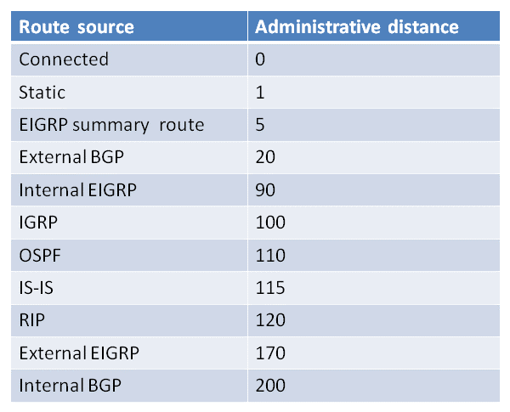
Administrative distance

